Slide 1
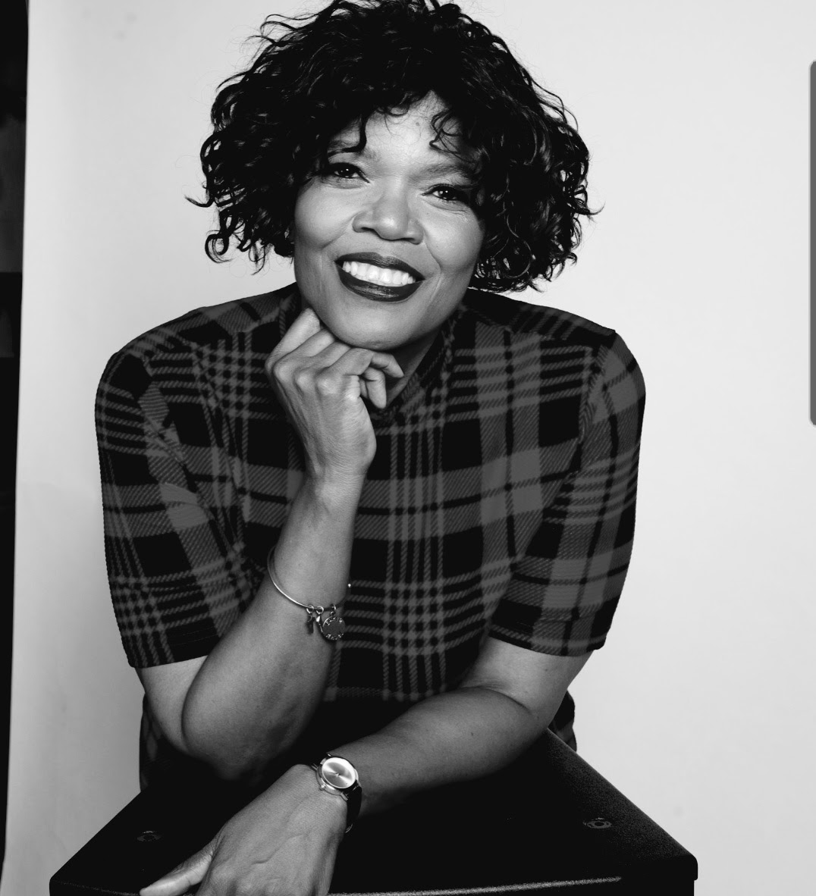
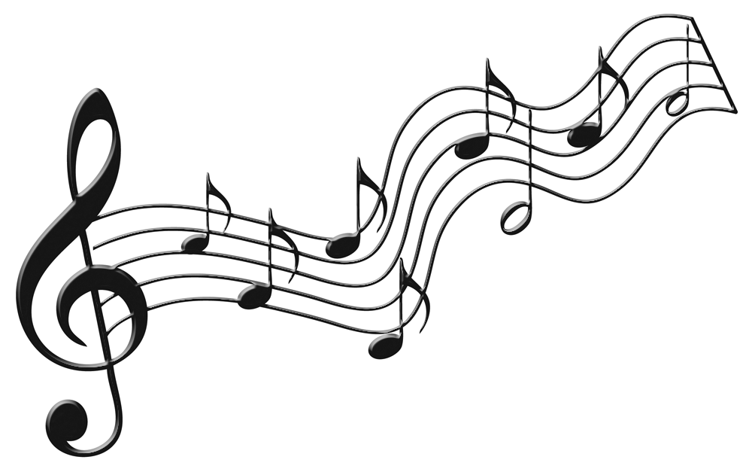


~ For those who appreciate C-R-E-A-T-I-V-E Worship ~
“There’s A Message In The Music”

Slide 2
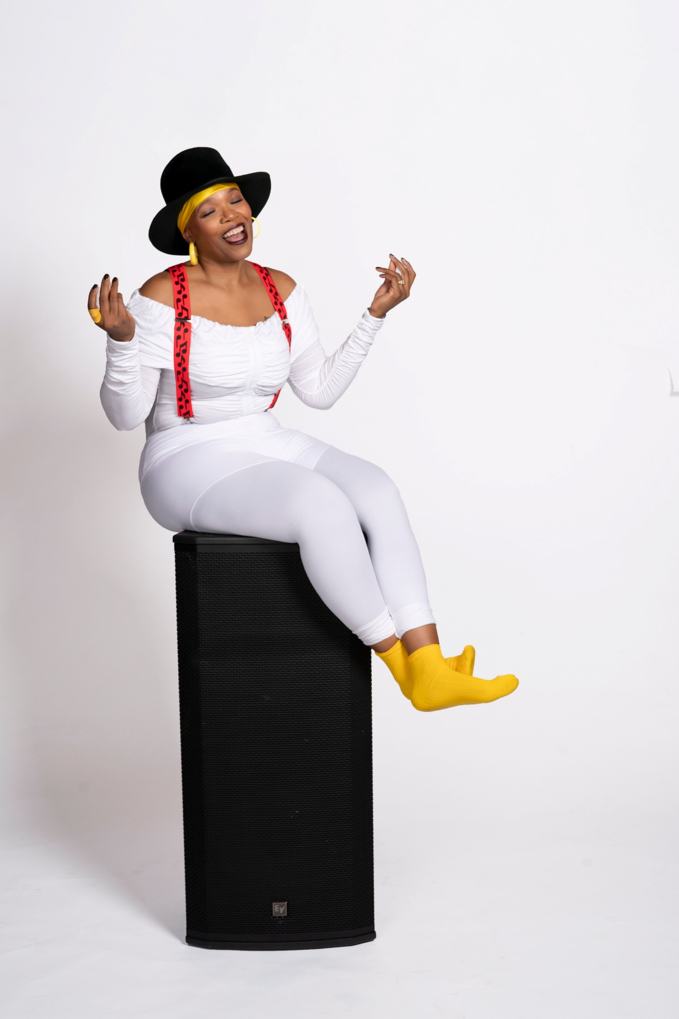
“It Grooves You”

Slide 3
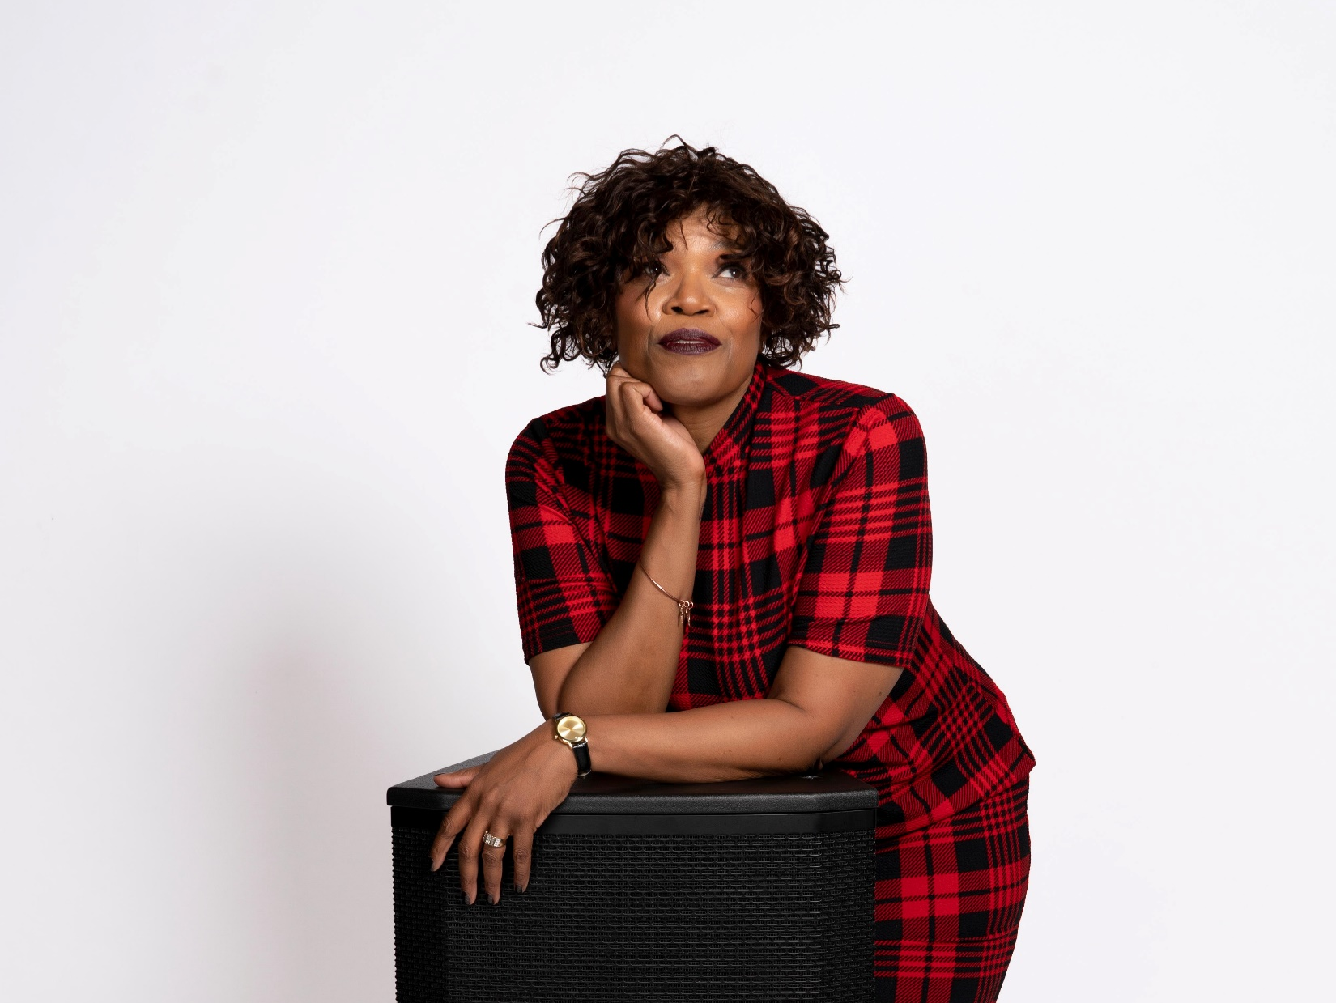
“It Mystifies You”

Slide 4
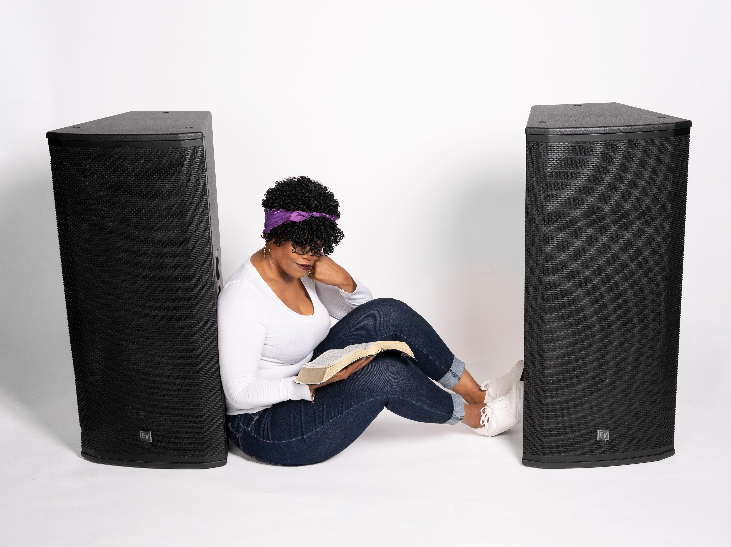
“It Leads You”
“To the WORD of God”

